Slide 1
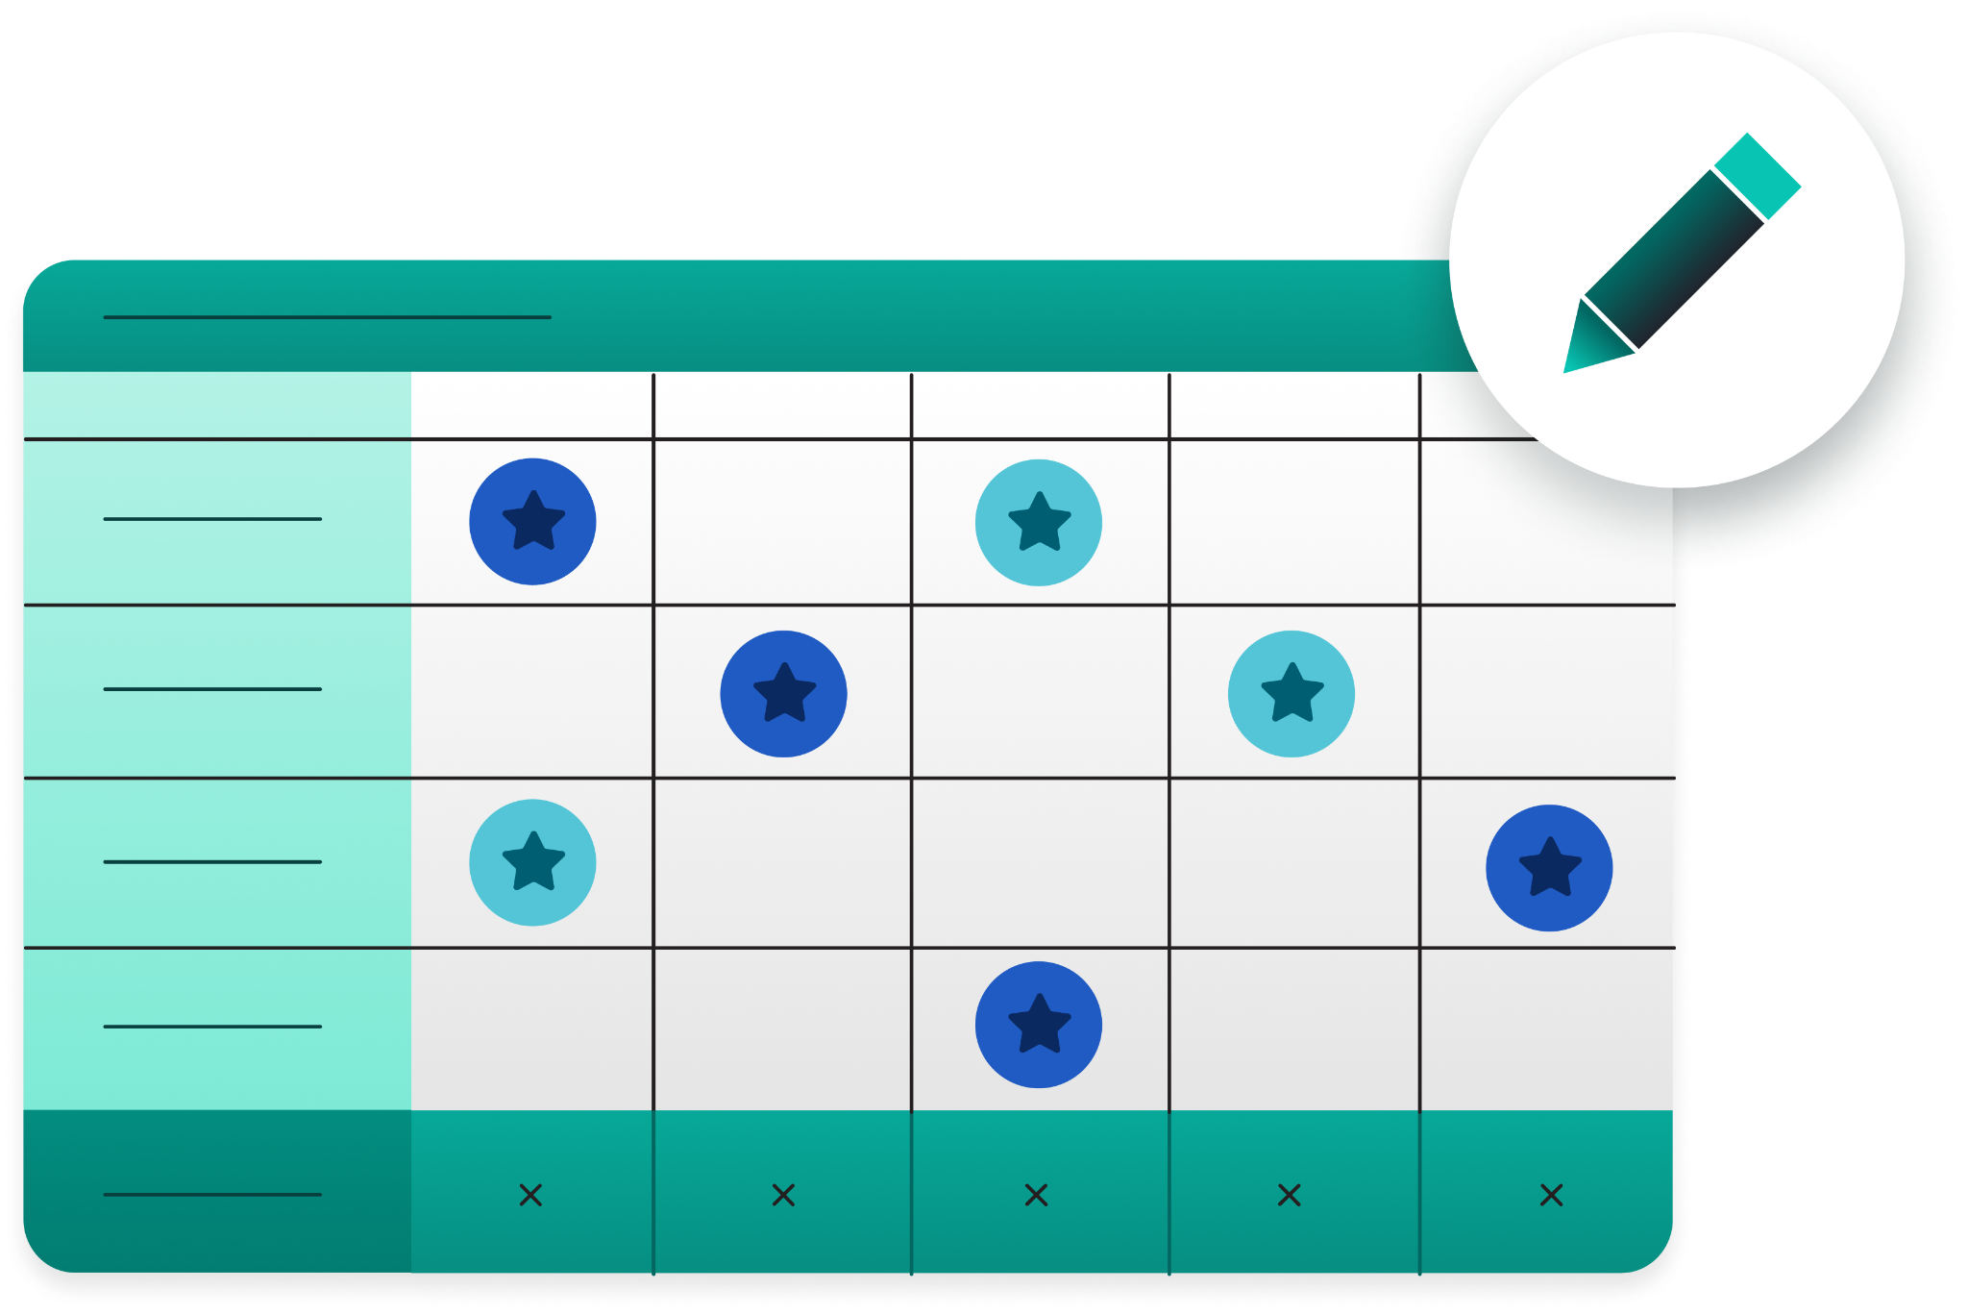
Social Media Scorecard Templates to Keep Your C-Suite Informed
White co-brand logo
goes here
+
Co-brand minimally and only on the title and thank you slides.
How to download a png logo on google images:
1. Google Image Search company name + white logo
2. Select “tools” under the search bar
3. Select “color” > “Transparent”
4. This will filter results to PNGs
5. Drag your png onto your slide, resize it to fit within the dotted rectangle, and delete the dotted rectangle when done.
Delete this box when done.

Slide 2
How to use these templates
Performance & Pipeline Snapshots
Share with your CEO and CMO on a monthly basis for a digestible overview of your brand health and social strategy.
Competitive Scorecard
Share with your CEO, CMO and CFO on a monthly or quarterly basis to contextualize your performance within your competitive landscape.
ROI Scorecard
Share with your CMO and CFO when they’re evaluating budgets or you’re trying to secure buy-in and resources.
Customer Care Scorecard
Share with your CMO and CXO on a monthly or quarterly basis to review team efficiency and identify new opportunities to improve customer satisfaction.
Fill in your data to tell your C-suite a compelling data story about social media’s impact on your business.
The templates are designed to zoom in on the social media intelligence leaders care about most.
Update the slides with your brand assets before sharing with stakeholders.

Slide 3




See speaker notes for customization instructions.
Social Exec Summary
We ended [mo./qtr.] with a [strong, weak, etc.] performance, including notable [+/-] in [objective] [MoM/QoQ] .
[Bright spot]
[Yellow/Red Flag]
[Actions based on that and blurb on the implications.]
[Metric one]
[Metric two]
[Metric three]
Notes:
Give your executive team an overview of your monthly or quarterly performance. Highlight performance wins, flag potential hurdles and share recommended action items. No need to get too in-depth here—the scorecards will provide stakeholders with more granular insights.

Slide 4
See speaker notes for customization instructions.
Organic Social + Influencer Impressions
Avg. Engagement Rate
Directional Pipeline
Conversions + Leads
XM +X% YoY
X% to 2025 goal
X% +X% YoY
Goal = X%
XK +X% YoY
XK +X% YoY
X% to goal
Pipeline Channel Performance
Cost Per Lead
(Paid + Influencer)
Earned + Owned
Media Value
Return on Ad Spend
CHANNEL 1: drove $XXk
CHANNEL 2: drove $XXk
Influencer: X
XX% to 2025 goal
Paid: X
Increase of $X YoY
Earned: XK
+X% YoY
102% to 2025 goal
Owned: XK
XK X% YoY**
2024: 1.0
Goal: 2.4
Notes:
Customize this slide to highlight the social media KPIs that matter most to your organization. Rearrange or remove squares as needed. Many of these KPIs rely on properly tracked UTM parameters to connect data between Google Analytics, Salesforce and/or and other CRM tools. If that data isn’t available, replace those metrics with what you’re currently tracking and reporting to your leadership team
Though some of these metrics can be calculated manually across your tech stack, the most efficient way is to use a social media management platform. If you’re using Sprout, you can find this data in the following reports/integrations:
Directional pipeline, conversions + leads, pipeline channel performance can be measured through diligent UTM practices alongside Sprout’s integration with CRM systems, like Salesforce.
Earned Media Value measures the performance of an employee advocacy strategy, and can be sourced from Employee Advocacy by Sprout Social.
Owned Media Value is a metric the Sprout social team uses to put a dollar value behind our organic social efforts. We get this number by dividing our monthly impression count by 1,000, and multiplying the result by our CPM—how much an advertiser pays for every 1,000 ad impressions.

Slide 5
See speaker notes for customization instructions.
Organic Social + Influencer Impressions
Directional Pipeline
XXM +XX% YoY
100% to 2025 goal
$XK
Conversions (Leads, Downloads + Webinar Reg)
Average Engagement Rate
X.XK +XX% YoY
XX% to 2025 goal
X.X% +X% YoY
Goal = X.X%
Notes:
This is an additional scorecard format.
Customize this slide to highlight the social media KPIs that matter most to your organization. Rearrange or remove squares as needed. Many of these KPIs rely on properly tracked UTM parameters to connect data between Google Analytics, Salesforce and/or and other CRM tools. If that data isn’t available, replace those metrics with what you’re currently tracking and reporting to your leadership team

Slide 6
Customer Care Scorecard
How our customer care metrics align with consumer expectations and industry standards
 | Total Received Messages | Total Actioned Messages | Action Rate | Average Time to Action | Average Reply Wait Time | Task Resolution Rate | CSAT Score
[Your Brand]
Internal SLA
Notes:
Your SLA is the commitment between a service provider (your company) and a client (your customers) that includes the predetermined agreement of standards you must adhere to, and the metrics you will use to measure performance. To fill this card out, ask yourself: What service promises has your company made to your customers? How does your actual performance compare? Use the answers to complete the third row of the dashboard.
To find your actual performance metrics, you can manually sort through your various social inboxes and customer surveys, or you can use a social media management platform like Sprout. If you’re using Sprout, you can find these metrics in the Inbox Activity Report and the Customer Feedback Report.

Slide 7
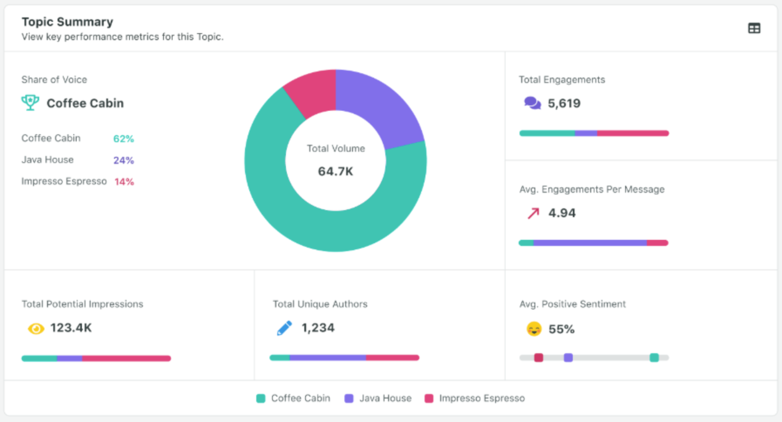
See speaker notes for customization instructions.
Brand | Audience Size | Sentiment | Potential Impr.
Competitor 1 | XX +X% MoM | XX% | XX
Competitor 2 | XX +X% MoM | XX% | XX
Your Brand | XX +X% MoM | XX% | XX
Competitor 3 | XX +X% MoM | XX% | XX
Competitor 4 | XX +X% MoM | XX% | XX
Competitive Scorecard
Include a short paragraph of key insights if needed.
Keep it to a few sentences.
💡If you use Sprout Social Listening…
You can link directly to your competitive analysis listening topic. Customers with the Listening add-on can share a link to their Listening Insights, even if your stakeholders don’t have a Sprout account.
Notes:
Though some of these metrics can be calculated manually in the individual social networks, the most efficient way is to use a social media management platform. If you’re using Sprout, you can find this data in the Listening Competitive Analysis Performance Report.

Slide 8
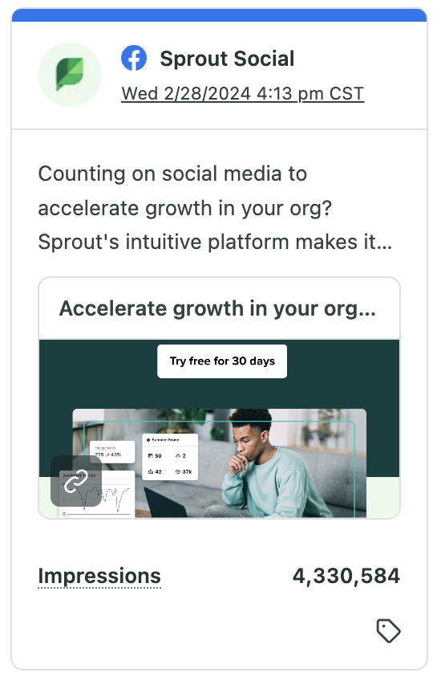
Top performing posts
See speaker notes for customization instructions.
Top Post by Engagements
Top Post by Impressions
Top Post by Conversions
Top Boosted Post by Performance
Top Performing Influencer Post
Notes:
Update these tiles to showcase your top-performing posts for the month or quarter. If you’re using Sprout, most of this data is available in the Post Performance Report. For the rest, follow these steps
Top Post by Conversions: Find this in Google Analytics by tracking UTM parameters tied to post links.
Top Performing Post by Influencer:Use Sprout Social Influencer Marketing or Sprout’s Tagging feature. You can also compare influencer post performance manually.

Slide 9
Key insight and actions
See speaker notes for customization instructions.
Insight:
Further invest in [include initiatives and strategies] on [platforms] to improve [include metric(s)]
Actions:
[Include specific data-driven tasks]
Notes:
Update these slide to reflect key insights and action items you’d like your audience to walk away with.

Slide 10
Key insights and actions
See speaker notes for customization instructions.
Insight:
Further invest in [include initiatives and strategies] on [platforms] to improve [include metric(s)].
Insight:
Further invest in [include initiatives and strategies] on [platforms] to improve [include metric(s)].
Actions:
[Include specific data-driven tasks]
Actions:
[Include specific data-driven tasks]
Notes:
This is an additional key insight and action slide. Update these slide to reflect key insights and action items you’d like your audience to walk away with.

Slide 11
Key insights and actions
See speaker notes for customization instructions.
Insight:
Further invest in [include initiatives and strategies] on [platforms] to improve [include metric/s)].
Insight:
Further invest in [include initiatives and strategies] on [platforms] to improve [include metric/s)].
Insight:
Further invest in [include initiatives and strategies] on [platforms] to improve [include metric/s)].
Actions:
[Include specific data-driven tasks]
Actions:
[Include specific data-driven tasks]
Actions:
[Include specific data-driven tasks]
Notes:
This is an additional key insight and action slide. Update these slide to reflect key insights and action items you’d like your audience to walk away with.

Slide 12
Thank you. Questions?
White co-brand logo
goes here
+
Notes:
Wrap your presentation up with a call for Q&A.

Slide 13
Bonus: Showcasing ROI on tool investments

Slide 14
Understanding the ROI of your social media management tool
The 2024 Social Media Productivity Report found that 55% of marketers using dedicated social media management platforms say their efforts significantly drive revenue—more than double the 23% of those without such tools.
Investing in the right software can turn social media into a strategic growth engine.
Use the following slides to make the case for an intuitive, unified social media management platform—like Sprout Social—or to advocate for additional investments in your strategy.

Slide 15
Explaining the ROI of Sprout
Quantify the value of social customer care
Show how Sprout streamlines engagement & troubleshooting, freeing up your team to focus on high-value interactions.
Demonstrate reporting ROI
Illustrate the time savings and improved insights gained through Sprout's unified reporting dashboards.
Quantify
efficiency gains
Showcase value of time saved with an easy-to-use, intuitive tool like Sprout.
Provide an investment summary
Provide a concise cost/benefit analysis showcasing the potential return on your investment in Sprout.
Notes:
Social media management tools drive efficiency and ROI beyond just content creation. It showcases time savings and improved accuracy through streamlined reporting, customer care and automation, allowing teams to focus on strategic, high-impact activities.

Slide 16

Benefit #1: Social Media Team Productivity
$XXK
See speaker notes for customization instructions.
 | Metric | Value
Enabled By
A | Number of Hours per Week Each Employee Devotes to Scheduling, Listening, Publishing, and Planning Campaigns | XX
B | Productivity Lift with Sprout Social | 60%
C | Size of Social Media Team | X
D | Work Weeks | 49
E | Annual Hours Saved per Year (A*B*C*D) | X
F | Fully-Loaded Hourly Cost per Team Member | $57
 | Value of Time Saved (E*F) | $XX,XXX
Sprout's engagement tools eliminate your team's manual tasks by handling large volumes of social messages through AI and automation.
Simplify collaboration and post content with unanimous approval. Easily share your content calendar with external stakeholders, work together with calendar notes and interact real-time with internal conversations.
Annual Benefit
Benchmarks
Social media team see a time savings of 60% on scheduling and publishing posts,
social listening, replying on social media channels, and planning campaigns.
Source: The Total Economic Impact™ Of Sprout Social, January 2025*
Notes:
This slide highlights Sprout Social’s cost-saving benefits in terms of social media team productivity The slide is currently filled with placeholder data, so you can get a better idea of what the finished product will look like.
To calculate your organization’s annual savings, update the table with:
A: Your estimated weekly time spent on social media listening, publishing and scheduling, along with planning social media campaigns.
B: This is the average productivity lift Sprout users experience through Sprout’s unified social media management platform. Leave this number as is.
C: Update this row with your total number of team members.
D: The number of weeks in a year. Leave this number as is.
E: Multiply Value A by Value B by Value C by Value D.
F: This is the estimated cost of a fully-loaded hourly team member, assuming they make $100K/1,920 working hours per year. Update this number with a salary more accurate to your organization, or leave it as is.
To calculate the value of time saved, multiply Value E by Value F. Then, update the annual benefit flag at the top of the slide.
*A commissioned study conducted by Forrester Consulting on behalf of Sprout Social. Results are for a composite organization representative of interviewed customers.

Slide 17
Benefit #2: Reporting
$XXK
See speaker notes for customization instructions.
 | Metric | Value
Enabled By
A | Time Spent per Month with Manual or Custom Reporting | XX
B | Time Saved with Sprout Platform | 90%
C | Time Saved per Day per Team Member (A*B) | X
D | Team Members | X
E | Work Days | 12
F | Total Hours Saved (C*D*E) | XXX
G | Fully-Loaded Hourly Cost per Team Member | $57
 | Value of Time Saved (F*G) | $XX,XXX
Save time by zeroing in
on only the data you need to see at the moment. Advanced filtering helps your team focus on metrics that matter with filters based on tags, content and message type.
Filter based on tags, content and message type to spotlight the metrics that matter most for different pieces of content.
Flexibility to pull analytics from different brands and platforms for any time period
Annual Benefit
Benchmarks
80% reduced manual reporting time
Source: The Total Economic Impact™ Of Sprout Social, January 2025*
Notes:
This slide highlights Sprout Social’s cost-saving benefits, specifically the time saved on reporting. The slide is currently filled with placeholder data, so you can get a better idea of what the finished product will look like.
To calculate your organization’s annual savings, update the table with:
A: Your estimated monthly time spent on manual or customer reporting.
B: This is the average amount of time Sprout users save per month through Sprout’s reporting tools, per The Total Economic Impact™ Of Sprout Social, March 2025. Leave this number as is.
C: Multiply Value A by Value B.
D: Update this row with your total number of team members.
E: The number of months in a year. Leave this number as is.
F: Multiply Value C by Value D by Value E.
G: This is the estimated cost of a fully-loaded hourly team member, assuming they make $100K/1,920 working hours per year. Update this number with a salary more accurate to your organization, or leave it as is.
To calculate the value of time saved, multiply Value F by Value G. Then, update the annual benefit flag at the top of the slide.
*A commissioned study conducted by Forrester Consulting on behalf of Sprout Social. Results are for a composite organization representative of interviewed customers.

Slide 18
Benefit #3: Social Care Productivity
$XXK
See speaker notes for customization instructions.
 | Metric | Value
Enabled By
A | Number of Customer Service Specialists | XX
B | Time Savings from Sprout Social | 10%
C | Hours per Week | 40
D | Work Weeks | 49
E | Months | 12
F | Annual Hours Saved per Year (A*B*C*D) | XX
G | Average Fully Burdened Hourly Cost per Specialist | $44
 | Value of Time Saved (E*F) | $XX,XXX
Case management tools that enable care teams to provide faster, more efficient support.
Enhanced team collaboration fostered through Sprout’s multitude of network and software integrations.
Increased visibility into brand conversations happening across social through social listening tools.
Annual Benefit
Benchmarks
Sprout customers uncovered productivity gains of 10% by leveraging social data to streamline customer support in their platform of choice.
Source: The Total Economic Impact™ Of Sprout Social, January 2025*
Notes:
This slide highlights Sprout Social’s cost-saving benefits, specifically the time saved on social customer care efforts.. The slide is currently filled with placeholder data, so you can get a better idea of what the finished product will look like.
To calculate your organization’s annual savings, update the table with:
A: The number of customer service specialists monitoring social media cases.
B: This is the average amount of time Sprout users save on social customer care efforts. Leave this number as is.
C: The number of hours per week. Leave this number as is.
D: The number of work weeks in a year. Leave this number as is.
E: The number of months in a year. Leave this number as is.
F: Multiply Value A by Value B by Value C by Value D.
G: This is the estimated hourly cost of a fully burdened customer service specialist. Update this number with a salary more accurate to your organization, or leave it as is.
To calculate the value of time saved, multiply Value E by Value F. Then, update the annual benefit flag at the top of the slide.
*A commissioned study conducted by Forrester Consulting on behalf of Sprout Social. Results are for a composite organization representative of interviewed customers.

Slide 19
Benefit #4: Lead Generation
$XXK
See speaker notes for customization instructions.
Channel | FY25 Lead Opportunity Value
Social Employee Advocacy | $XK
Social Influencer | $XK
Social LinkedIn | $XK
Social YouTube | $XK
Other | $XK
Total | $XXK
Lead Value
[Insert screenshot from your social media performance dashboard here]
Notes:
Social isn’t just about engagement—it directly contributes to revenue. Pipeline impact, conversions, and lead generation can be measured through diligent UTM tracking alongside Sprout’s CRM integrations, like Salesforce.
If your organization already has multi-touch attribution set up, your social team can work with marketing operations and analytics using your CRM in combination with a marketing attribution tool. This process involves:
Ensuring consistent UTM tagging across campaigns for accurate attribution.
Defining the key metrics you want to track (e.g., pipeline influenced by social, conversion rates, lead quality).
Partnering with analytics to surface social’s contribution within existing reporting structures.
If multi-touch attribution isn’t in place, start by identifying whether it’s been discussed internally and advocate for its implementation. In the meantime, UTM tracking remains the best way to connect social efforts to conversions.
Next Steps: Work with your marketing analytics team (or whoever owns marketing reporting) to define social's role in lead generation. Then, update this slide with a screenshot of your social media performance dashboard.

Slide 20
Benefit #5: Earned Media Value through Employee Advocacy
XX,XXX
XX
$XXXK
XXK
XXM
See speaker notes for customization instructions.
Total Shares
Active Stories
Earned Media Value
Network | Impressions (CPM)
LinkedIn | $xx.xx
X (Twitter) | $xx.xx
Facebook Page | $xx.xx
Insta. Business Profile | $xx.xx
Total Clicks
Total Potential Reach
* Users + Sprout Main
Notes:
This slide highlights Earned Media Value gained through Employee Advocacy by Sprout Social. The slide is currently filled with placeholder data, so you can get a better idea of what the finished product will look like.
If you’re using Employee Advocacy by Sprout Social, use your General Report to update the figures on this slide.

Slide 21
Exec. Investment Summary (TEI based)
XXX% | xX Return
See speaker notes for customization instructions.
Annual Benefits vs.
Annual Sprout Investment
Total ROI
$898,042
Benefit Details
Benefit Detail
Cost Detail
$XXK Total Efficiency Gains (Benefits 1-3)
$XXK Lead Generation from Social (Benefit 4)
$XXK Earned Media Value (Benefit 5)
$XXK Total Efficiency Gains (Benefits 1-3)
$XXK Lead Generation from Social (Benefit 4)
$XXK Earned Media Value (Benefit 5)
$xxK [Provide a brief overview of what’s included in your current Sprout Social package. Include the number of seats you currently have, along with any premium add ons.]
Dollar Amount ($)
$171,996
$171,996
$55,404
Annual Benefits
Annual Costs
Notes:
This slide compares the estimated value of benefits against the cost of your Sprout Social subscription, providing a high-level overview of platform ROI. To find your total ROI, add up your total annual benefits, then divide that number by your annual Sprout investment.

